Slide 1
CCD versus CMOS Image Sensor Technology for Biometric Imaging Applications.
Chalk Talk Presentation Prepared for the Staff of
Nelcor/Puritan Bennett
Presented By: Nick Nickols,
Electronics Engineering Consultant

Slide 2
Chalk Talk Overveiw
Review the background and scope of an image sensor technology study I completed for Identix. Share with you what I learned.
Review the basics of Photo Sensor Theory .
Briefly Discuss two common Types of CCD image sensors.
Focus on CMOS Sensor classifications and operational details. This is where biometric imaging is headed.
Discuss a CMOS image sensor which competes with a CCD device for a “high end imaging application”.
Discuss the risks and benefits of designing in a CMOS for CCD replacement.
Technical Terms and Glossary
Extra Benefits for your viewing pleasure.

Slide 3
Project Background and Scope
Background :
Recently completed CMOS image sensor technology study for Identix senior management.
Identix develops and markets Biometric imaging systems (AFIS).
Identix has traditionally with expensive interline CCD image sensors and CCD line arrays.
Identix patents are dated. New competition entering the market.
Customers are complaining about current imaging system costs. Where can Identix reduce cost?
The CCD image sensor is a SONY part. Sony requires a five year minimum purchase agreement with the buyer.
Can the CCD be replaced?
SCOPE :
Interline CCD Cameras meet FBI Appendix F Specs image quality. (See Appendix).
CMOS image sensors are less expensive . Can a CMOS device meet FBI requirements ?
Need to understand fundamental differences between CMOS image sensors.
Is there an equivalent CMOS technology that can replace a CCD device ?
If so, develop a design spec for a CMOS finger roll camera.
Discuss risk and benefits of a CMOS camera design.
CMOS technology is new to Identix. Take the pain out of the learning curve and improve the odds for a successful design

Slide 4
PHOTO SENSOR THEORY
Photo Sensor Theory.
Both technologies, CCD and CMOS, are made from silicon. Silicon has some interesting properties due to its atomic structure. Silicon is classified as a "semiconductor" because of the covalent electron bonds between adjoining silicon atoms. The idea is that Silicon atoms share electrons. These electrons can go mobile without too much coaxing.
The energy in visible light is sufficient to break the covalent bonds thus freeing up electrons. The under lying principle is the "photovoltaic effect". When silicon is exposed to photons, electrons are released. The number of electrons released is dependent on light intensity. More photons convert more electrons.
Add impurities to the Silicon and you enhance the "photovoltaic effect", in essence creating a photodiode. Configure silicon photo diodes into an array of light sensing elements (pixels), and you now have a device which can sense a field of view. Voila, the solid state image sensor is born.
The principle of the "photovoltaic effect" holds true for CCD and CMOS devices. Both devices are built up of many light sensing photodiodes (photo gates are used by frame transfer CCDs). In both CMOS and CCD technologies, the charge (photocurrent) generated by the photodiodes is converted to a voltage. The difference between CCD and CMOS sensors is in conversion (buffering) of photo charge and how it is read out as a pixel voltage.
Getting into the internal differences of the various image sensor technologies will shed light on how to make appropriate design choices. Let's start with CMOS devices, then move onto CCD devices. From there we will compare the families on a chart. Then we will do a design exercise comparing a CMOS device to a CCD device in a camera front end.

Slide 5
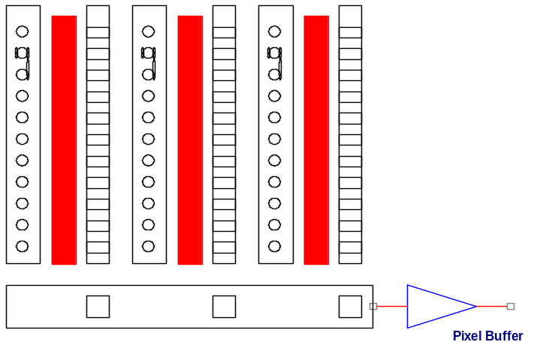
CCD Technology Overview
Interline CCD:
Very common in Biometric imaging applications
Full frame transfer devices
Used in Cameras used in astronomy, photo chemistry and extremely low light level applications.
Very high resolution and QE

Slide 6
Interline CCD Technology Simplified
Vertical Charge transfer Gate
Vertical CCD Shift Register
Photo Diodes(Pixels)
Vertical Column Registers Shift in Parallel
Horizontal Charge transfer Gate
Horizontal CCD Shift Register
Pixel Buffer
Horizontal Pixels Shift Horizontally.

Slide 7
Full frame CCD Technology Simplified

Slide 8
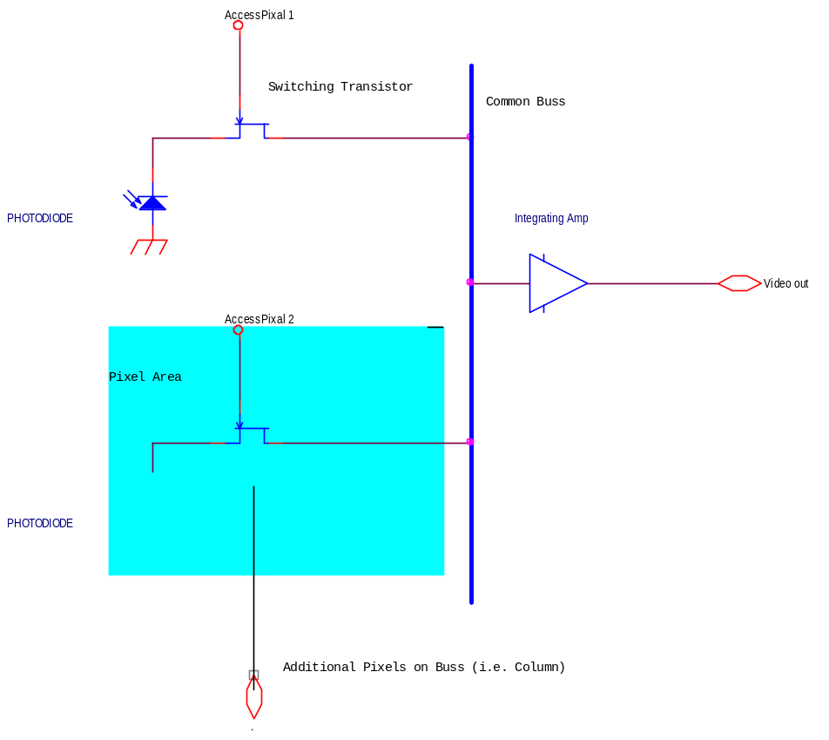
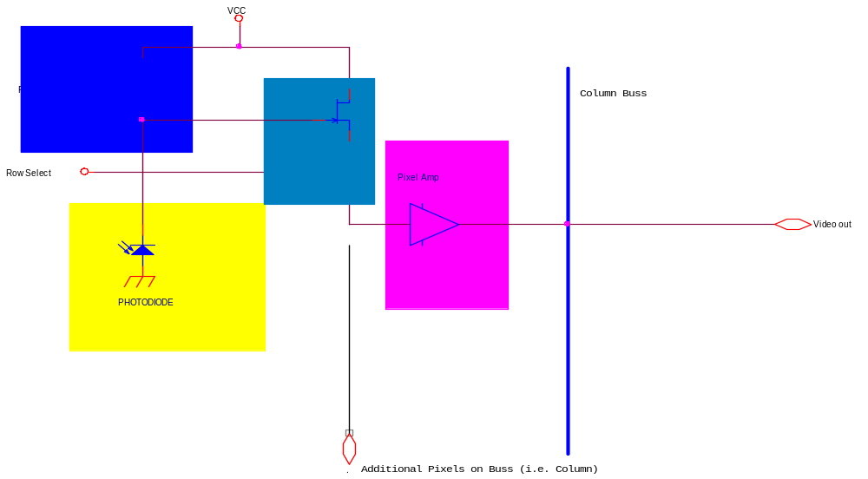
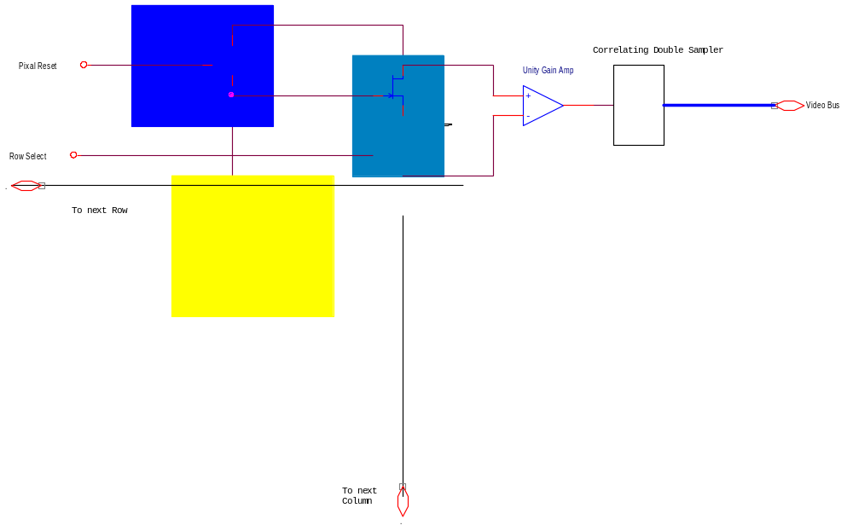
CMOS Image Sensor Technology Overview
Passive Pixel Devices
Active Pixel Devices
Active Column Devices

Slide 9
Passive Pixel Technology
Passive pixel sensors have been around the longest, even a little longer than CCD devices. The architecture is quite simple, as shown in the figure below. The passive pixel device is a photodiode connected to a transistor switch.

Slide 10
Operation of Passive Pixel Image Sensor (Mother of all CMOS image sensors)
In operation, these devices have what is known as a "photo charge integration period". During this time, the photodiode is exposed to light. The light is converted to charge (photocurrent). After a timed conversion period, a controller switches the charge onto a bus in a timed sequence. At the end of the bus is an integrating buffer which converts the charge into a voltage. The voltage is then read out as analog value. Commercial versions of these devices provide a formatted output compatible with CIF or NTSC video displays.
These passive devices have good photon conversion efficiencies (Quantum Efficiency). This is due to the size of the photodiode. Passive pixel devices can be quite sensitive even in the dark. Due to the simplicity of the support circuitry more of the silicon real-estate can be devoted to the photodiode. When a sensor has more area devoted to photodiode sites, it is said to have a high “fill factor". The early versions of these devices had poor signal to noise characteristics. The noise generated by the readout process typically limited the signal to noise ratio of these devices. Switching noise gets worse as the number of switching elements increases.
The passive pixel sensors were limited in the number pixels. Further complications occurred with process non-uniformities in the pixel switching transistors. This impacted what is known as "fixed pattern noise". Fixed pattern noise can be cancelled with analog processing techniques such as double correlated sampling. We will discuss this later during the design exercise. The OVTxxxx is an example of the commercially available PPs device technology.

Slide 11
Active Pixel Technology
Active-pixel sensors (APS), shown in figure below, were the next step in CMOS image sensor evolution

Slide 12
Operation of Active Pixel Technology
An open loop "source follower amplifier" was added to follow the pixel select transistor. The source follower reduces read out noise.
The APS tends to suffer in the sensitivity department due to a loss of photodiode area. They have a lower fill factor than passive pixel devices.
They also suffer from process non-uniformities in the source follower. This degrades fixed pattern noise. Use of analog noise canceling must be applied to improve performance.

Slide 13
ACS Technology
The latest advancement in CMOS image sensors is the Active Column Sensor.

Slide 14
Operation of Active Column Sensor.
In this sensor arrangement, the follower buffer is eliminated from each pixel element. This leaves more room for sensor area. At the top of each pixel array column, is a closed loop "unity gain amplifier". A correlated double sampler follows the amplifier and drives the video bus. Further processing occurs away from the active pixel array with improvements in noise. The advantages are better sensor dynamic range and lower fixed pattern noise. The fill factor of the sensor array portion of the ACS devices is higher than the ACS technology. The Zoran ZR32112 is an example of this technology. Zoran digitizes the pixels within the chip.
The ACS technology combines excellent Fill Factor and chip integration.
The Zoran ZR32112 compares very well to the Sony ICX825.
By comparing data sheets, the ZR32112 appears to be a potential replace for the ICX285.

Slide 15
Zoran/Sony Comparison
Table 1 Zoran ZR32112 GEN1 Sony ICX085L CCD
ZR32212 GEN 2. ICX285 CCD
Array Resolution
1304H × 1032V / 1288H×968V
1360H× 1030V
Active Pixels
1288H× 1032V
1300H× 1030V
Array Format
¾’’ (12.3mm diagonal) ½”(9.67mm)
2/3” (11 mm diagonal) 4to 3 ratio/Same
Pixel size
7..5μm × 7..5μm
6μm × 6μm
6.7μm × 6.7μm
6.45μm × 6.45μm
Scanning Mode
Progressive
Progressive
Max Pixel Rate
16-24 Mhz
20.25 Mhz/ 28.64 Mhz
Frame Rate
9.3 FPS at 16mhz 14 FPS@24mhz/15FPS
12 FPS/15FFPS
Exposure Time
Programmable down to 1 msec.
?
Saturation
1VDC
400 mV
Temporal Noise
Typ. 400μV
?
Dynamic Range
66dB / 62dB
48dB.
A/D Resolution
10 bits
Analog output. (9 bit conversion)
A/D non Linearity
+/- ½ LSB
?
Supply Voltages
3.3 V
Vdd= 15 Volts, 5, –12.5
Power Dissipation
< 250mW <280mW
<750 mW
Chip package
44 LLCC (.050 pitch)
Ceramic Dip (.080 pitch)
Dark Signal
TBD
8mV
Cost
$69 1-10 quantity
$550

Slide 16
CMOS Image Sensors System On A Chip
+3.3V
CMOS Image Sensor Array
Interface/AGC
10 bit ADC
Buffer/Drivers
Out Put Register
Timing and
Control Register
Voltage Ref.
Control
Control Register
I2C Buss
Clock In

Slide 17
Summary of CCD/CMOS Sensor Analysis
Parameter
PPS CMOS
APS CMOS
ACS CMOS
IT CCD
Signal to noise ratio
60+dB
48dB.
Dynamic Range
Quantum Efficiency
Image quality
Number of Active pixels
Cost

Slide 18
Summary of CMOS camera Advantages/Disadvantages
Advantages:
Greater on chip component integration.
Reduced Power Consumption in CMOS, no bucket brigade drive capacitance.
Pixel Address ability: Windowing
Manufacturing Cost: CMOS process technology is cheaper Than NMOS.
Competitive market.
Disadvantages/Risks:
Volume driven
Life cycle compatibility
Moving forward
Benefits out way risks for prototype development.
Work with vendor and buy product in advance.
Project got green light.

Slide 19
Camera System Design for Fingerprint imaging
Meet FBI appendix F specs.
Compatible with current Optics design.
Must interface with current image processing subassembly.
Must be software compatible with current image processor.

Slide 20
Typical CCD Camera/System
+ 5V
- 7.5V
+ 15V
+ 5V
+ 5V
+ 5V
CCD Sensor
Horizontal Drivers
Raw Pixel Output
Pixel Buffer/AGC
Double Correlating A/D
Digital Output
+ 5V
Timing
Vertical Drivers
/Sync
+ 5V
+ 15V
Notes
Each Bock is an Individual Component/s.
Typically three Power Supply Voltages Required

Slide 21
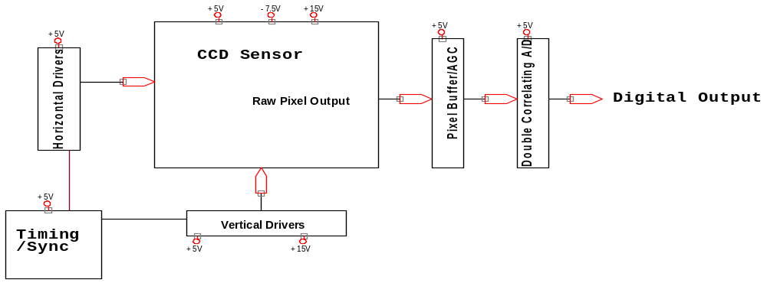
Design Specification for CCD Camera
BOM
1. Timing Generator: Oscillator and FPGA.
2. Vertical Drivers: Sony.
3. Horizontal Drivers: Standard CMOS buffer.
4. Pixel Amplifier: High Speed OpAmp /Buffer.
5. A/D Converter: Double Correlating A/D.
6. LVDS Bus interface: 9 bit digitized pixel, Frame Synch and Pixel clock is sent via LVDS driver.
7. Housing Keeping : PIC Micro.
8. Image Sensor : Sony ICX285
7

Slide 22
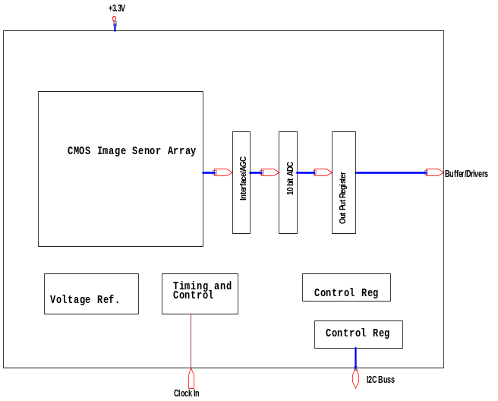
Cmos Design Spec
BOM:
PIC Micro
LVDS interface
Clock/Osc
Zoran Zr32112
PCB FAB.

Slide 23
Technical terms/Glossary
Fill Factor : amount of pixel capturing light. PPS fill factor > 80% APS >40%
Micro lenses: small lenses manufactured above the pixel. Serve to increase Fill Factor.
Read Noise (Also known as temporal noise): Occurs randomly due to drive electronics.
Fixed Pattern Noise: This noise results because each pixel has different light sensitivity characteristics. In CMOS sensor each pixel may have an amplifier. These amplifiers have slightly different gains and offsets due to manufacturing process variations.
Blooming: Too many photons at a pixel. The pixel current saturates causing current to leak into the adjacent pixel. Blooming is like overexposure in film photography. The condition appears as bright streaks in the image.
Aspect Ratio: Ratio between height and width of sensor. 640*480-pixel resolution would be 480/640 = ¾’.
Optical format: Number of inches determined by taking the diagonal measurement of the sensor in mm and dividing by 16. If a sensor measures 4mm diagonally, then 4/16 = 1/4’ format. Lens for cameras come in standard formats of ¼’, ½’, ¾’, etc.
Quantum Efficiency (QE): Imagers convert photon energy into electrical energy. The efficiency at which this conversion takes place is QE. The QE calculation is Electrons/Photons. If no electronics are created then the QE is zero. If one electron is created by one photon then QE is 100%. Image sensor efficiency varies with light wavelength.
Dark current: Thermally created electrons without illumination. Varies with manufacturing process, chip layout, and increasing temperature.

Slide 24
FBI Appendix F Specs For AFIS
500 Dots Per inch
Must resolve xx line pairs per mm. MTF.
S/N ratio xx db

Slide 25
The “who's who” of image sensing technology.
Only a small number of companies engaged in developing CCD devices have the resolution and signal to noise specifications compatible with forensic quality fingerprint imaging. The cost of these devices limits their application.
Sony , www.sony.com, has been supplying the ICX085 and now the ICX285.
Texas Instruments. www.ti.com. TI device have been evaluated in the past.
Kodak. www.kodak.com. Kodak produce very high quality Multi-Mega Pixel image sensors for high quality cameras.
Most of the players engaged in CMOS image sensing technology are involved with devices with VGA (640*480) pixels.
www.fillfactory.com/
www.photobit.com
http://www.agilent.com/view/Imaging/
http://www.vvl.co.uk/products/image_sensors/home.htm
http://www.ovt.com/omnicmoss.htm
Recent player joining the CMOS image sensor market.
http://www.kodak.com/country/US/en/digital/ccd/pr20000828-01.shtml
http://us.st.com/stonline/products/support/touchip/prod2.htm
1.3mega pixels and above.
Two local companies which have promise for Identix are:
www.zoran.com
www.y-media.com
Foveon Dr. Carver Mead Startup.
Very novel technology.
High fill factor because of clever design which emulates a human retina.
Different light wavelengths penetrate at different depths in the silicon. Red penetrates the top layer, green the middle layer, and blue the bottom layer.

Slide 26
Fun and FYI
Attaching a Peltier device to a CCD or CMOS imager improves thermally induced noise. By integrating successive frames of video CCD and potentially CMOS imagers can be used to image biotech fluorescence. Very low light levels of a few photons per pixel can be detected.
PPS imager such as “Sugar Cube” (cheap internet) cameras can be used for night vision or very low light level imaging by integrating multiple video frame and subtracting noise.

